Slide 1
Module -02
Linear Data Structures
(Linked List, Stack, Queue)
Karthikeyan S
Faculty/VIT University
Amaravati

Slide 2
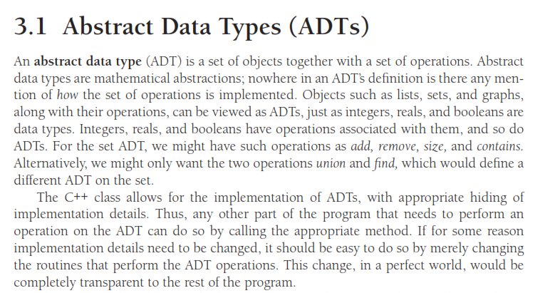
LIST ADT

Slide 3
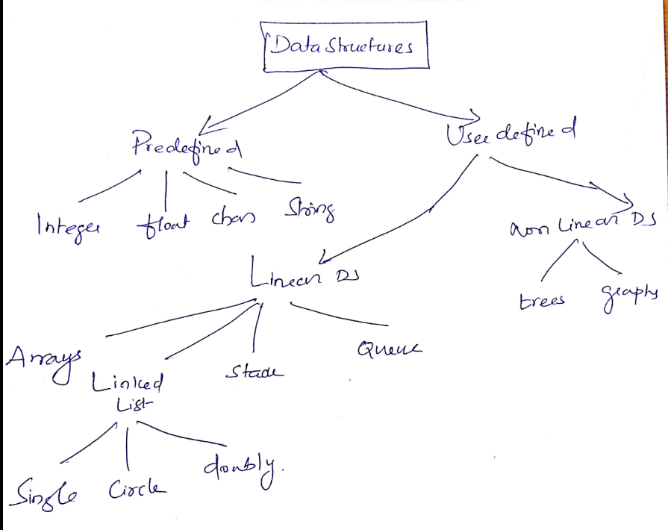

Slide 4
LL
Linked list is one of the most important data structures. We often face situations, where the data is dynamic in nature and number of data can’t be predicted or the number of data keeps changing during program execution.
Linked lists are very useful in this type of situations.

Slide 5
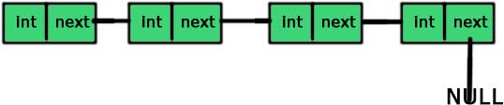
A linked list is made up of many nodes which are connected in nature. Every node is mainly divided into two parts, one part holds the data and the other part is connected to a different node(next pointer).

Slide 6
A linked list is a series of connected nodes, where each node is a data structure.
A linked list can grow or shrink in size as the program runs

Slide 7
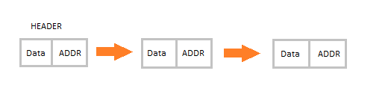
Linked List is a linear data structure and it is very common data structure which consists of group of nodes in a sequence which is divided in two parts. Each node consists of its own data and the address of the next node and forms a chain. Linked Lists are used to create trees and graphs.

Slide 8
Advantages of Linked Lists
They are a dynamic in nature which allocates the memory when required.
Insertion and deletion operations can be easily implemented.
Stacks and queues can be easily executed.
Linked List reduces the access time.
A linked list can easily grow or shrink in size.
Insertion and deletion of nodes is quicker with linked lists than with vectors.

Slide 9
Disadvantages of Linked Lists
The memory is wasted as pointers require extra memory for storage.
No element can be accessed randomly; it has to access each node sequentially.
Reverse Traversing is difficult in linked list.

Slide 10
Applications of Linked Lists
Linked lists are used to implement stacks, queues, graphs, etc.
Linked lists let you insert elements at the beginning and end of the list.
In Linked Lists we don't need to know the size in advance.

Slide 11
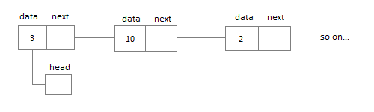
Types of Linked Lists
Singly Linked List : Singly linked lists contain nodes which have a data part as well as an address part i.e. next, which points to the next node in sequence of nodes. The operations we can perform on singly linked lists are insertion, deletion and traversal

Slide 12
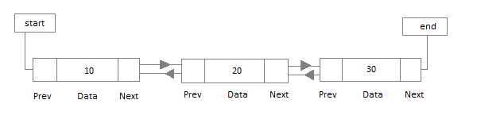
Doubly Linked List : In a doubly linked list, each node contains two links the first link points to the previous node and the next link points to the next node in the sequence.

Slide 13
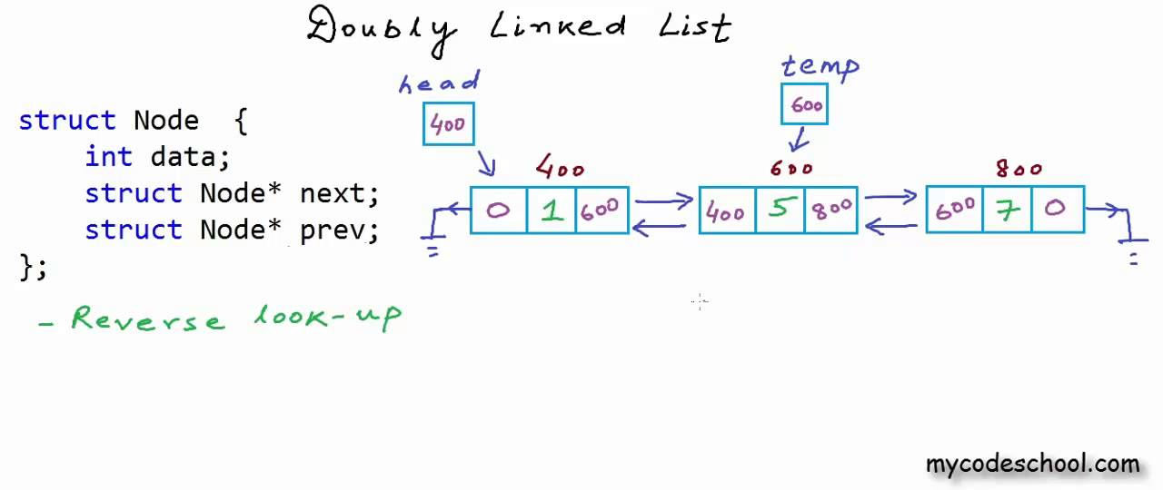

Slide 14
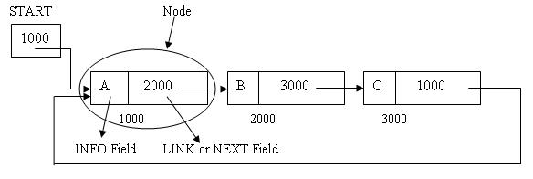
Circular Linked List : In the circular linked list the last node of the list contains the address of the first node and forms a circular chain.

Slide 15
Various Operations
Insertion(Beginning/End/positions)
Finding whether Linked List is empty or not.
Searching any element in the Linked List
Deleting a particular Node from the List

Slide 16
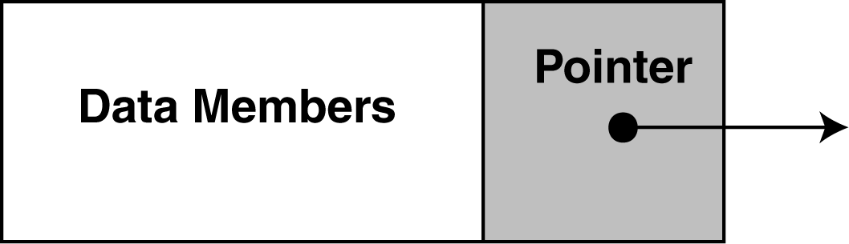
The composition of a Linked List
Each node in a linked list contains one or more members that represent data.
In addition to the data, each node contains a pointer, which can point to another node.

Slide 17
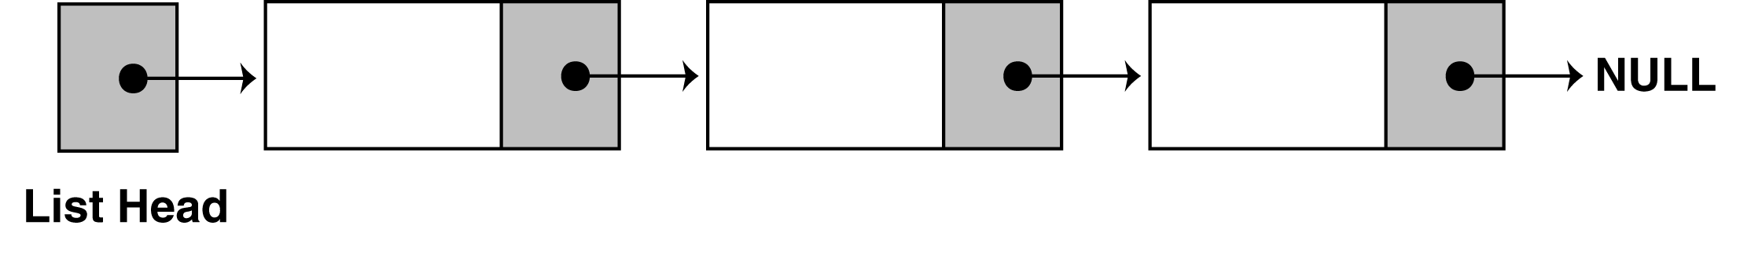
The composition of a Linked List
A linked list is called "linked" because each node in the series has a pointer that points to the next node in the list.

Slide 18
Declarations
First you must declare a data structure that will be used for the nodes.
For example, the following struct could be used to create a list where each node holds a float:
struct ListNode
{
float value;
struct ListNode *next;
};

Slide 19
Declarations
The next step is to declare a pointer to serve as the list head, as shown below.
ListNode *head;
Once you have declared a node data structure and have created a NULL head pointer, you have an empty linked list.
The next step is to implement operations with the list.

Slide 20
17.2 Linked List Operations
We will use the following class declaration (on the next slide), which is stored in FloatList.h.

Slide 21
Appending a Node to the List
To append a node to a linked list means to add the node to the end of the list.
The pseudocode is shown below. The C++ code follows.
Create a new node.
Store data in the new node.
If there are no nodes in the list
Make the new node the first node.
Else
Traverse the List to Find the last node.
Add the new node to the end of the list.
End If.

Slide 22
class FloatList
{
private:
// Declare a structure for the list
struct ListNode
{
float value;
struct ListNode *next;
};
ListNode *head; // List head pointer
public:
head = NULL;
void appendNode(float);
void insertNode(float);
void deleteNode(float);
void displayList(void);
};

Slide 23
void FloatList::appendNode(float num)
{
ListNode *newNode, *nodePtr;
// Allocate a new node & store num
newNode = new ListNode;
newNode->value = num;
newNode->next = NULL;
// If there are no nodes in the list
// make newNode the first node
if (!head)
head = newNode;
else // Otherwise, insert newNode at end
{
// Initialize nodePtr to head of list
nodePtr = head;
// Find the last node in the list
while (nodePtr->next) //checking whether nodeptr->next is Null
nodePtr = nodePtr->next;
// Insert newNode as the last node
nodePtr->next = newNode;
}
}
Note : nodePtr->next is not NULL, the while loop will execute. The next node becomes a NodePtr.

Slide 24
Program 17-1
// This program demonstrates a simple append
// operation on a linked list.
#include <iostream.h>
#include "FloatList.h”
void main(void)
{
FloatList list;
list.appendNode(2.5);
list.appendNode(7.9);
list.appendNode(12.6);
}
(This program displays no output.)

Slide 25
Stepping Through the Program
The head pointer is declared as a global variable. head is automatically initialized to 0 (NULL), which indicates that the list is empty.
The first call to appendNode passes 2.5 as the argument. In the following statements, a new node is allocated in memory, 2.5 is copied into its value member, and NULL is assigned to the node's next pointer.

Slide 26
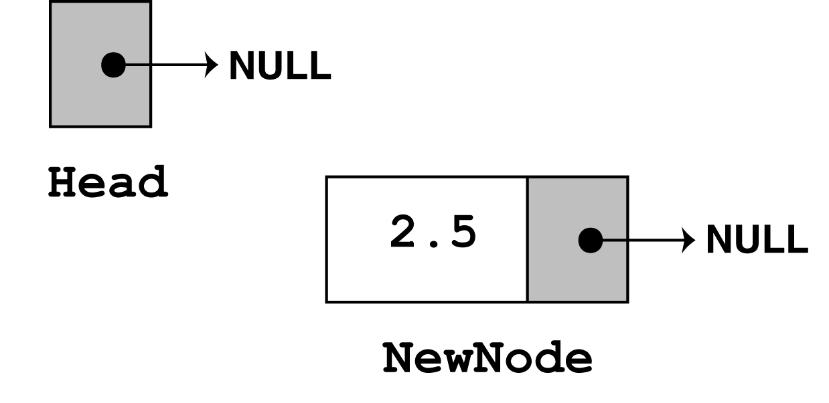
newNode = new ListNode;
newNode->value = num;
newNode->next = nULL;

Slide 27
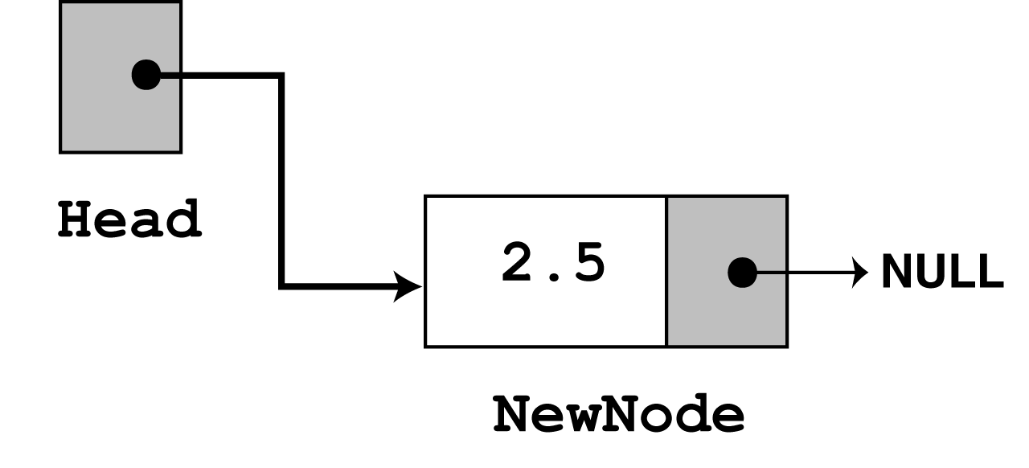
The next statement to execute is the following if statement.
if (!head)
head = newNode;
There are no more statements to execute, so control returns to function main.

Slide 28
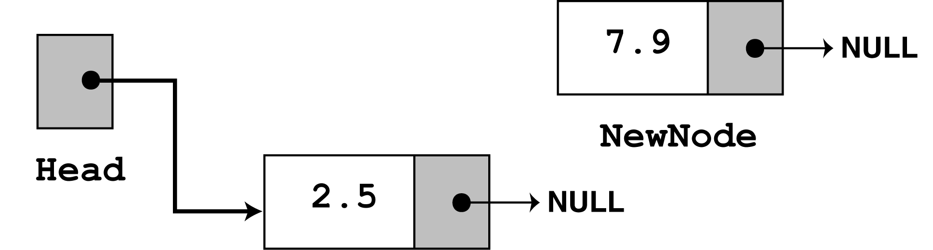
In the second call to appendNode, 7.9 is passed as the argument. Once again, the first three statements in the function create a new node, store the argument in the node's value member, and assign its next pointer to NULL.

Slide 29
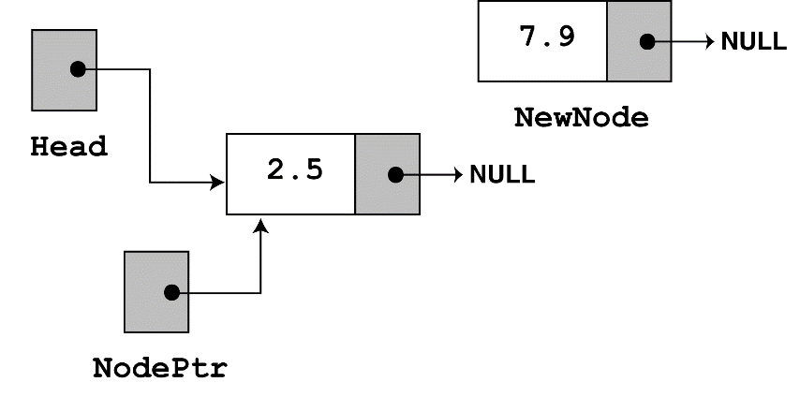
Since head no longer points to NULL, the else part of the if statement executes:
else // Otherwise, insert newNode at end
{
// Initialize nodePtr to head of list
nodePtr = head;
// Find the last node in the list
while (nodePtr->next)
nodePtr = nodePtr->next;
// Insert newNode as the last node
nodePtr->next = newNode;
}

Slide 30
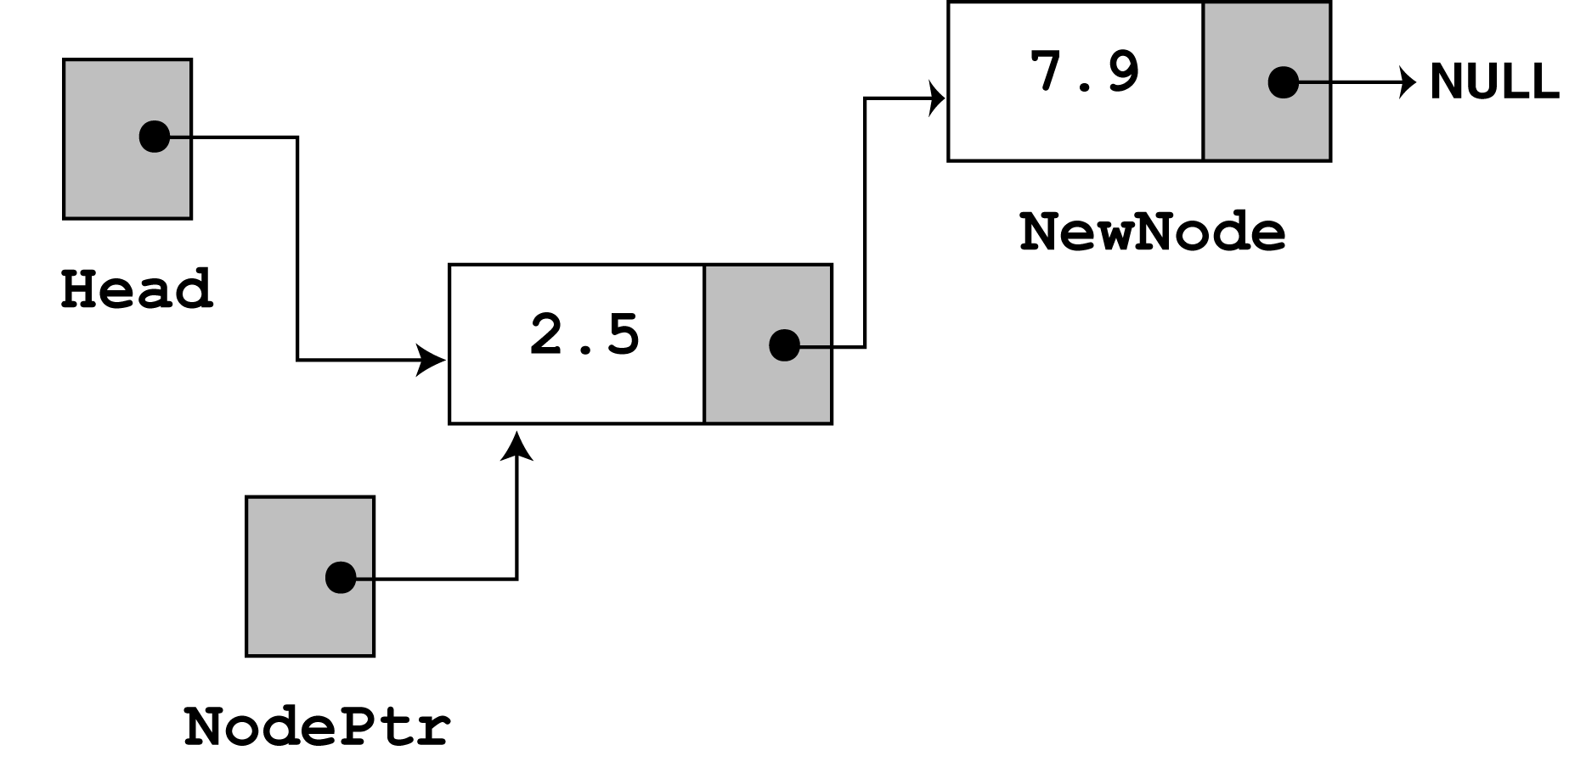
nodePtr is already at the end of the list, so the while loop immediately terminates. The last statement, nodePtr->next = newNode; causes nodePtr->next to point to the new node. This inserts newNode at the end of the list.

Slide 31
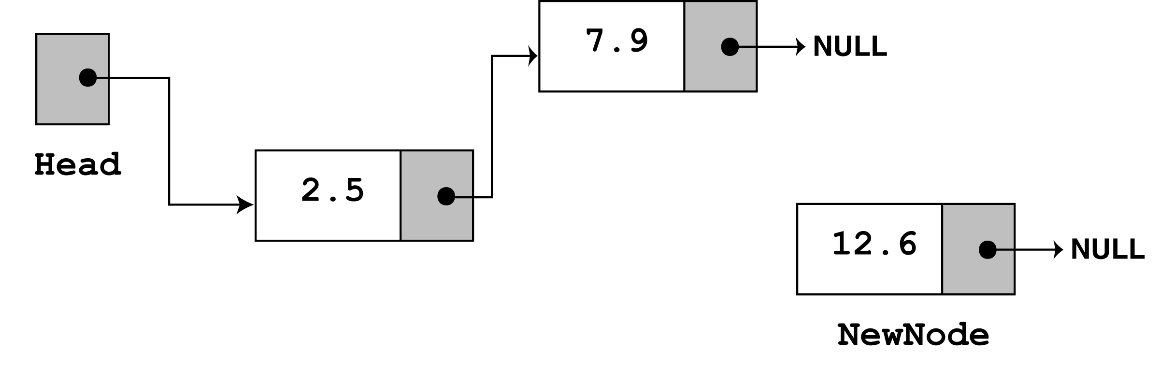
The third time appendNode is called, 12.6 is passed as the argument. Once again, the first three statements create a node with the argument stored in the value member.

Slide 32
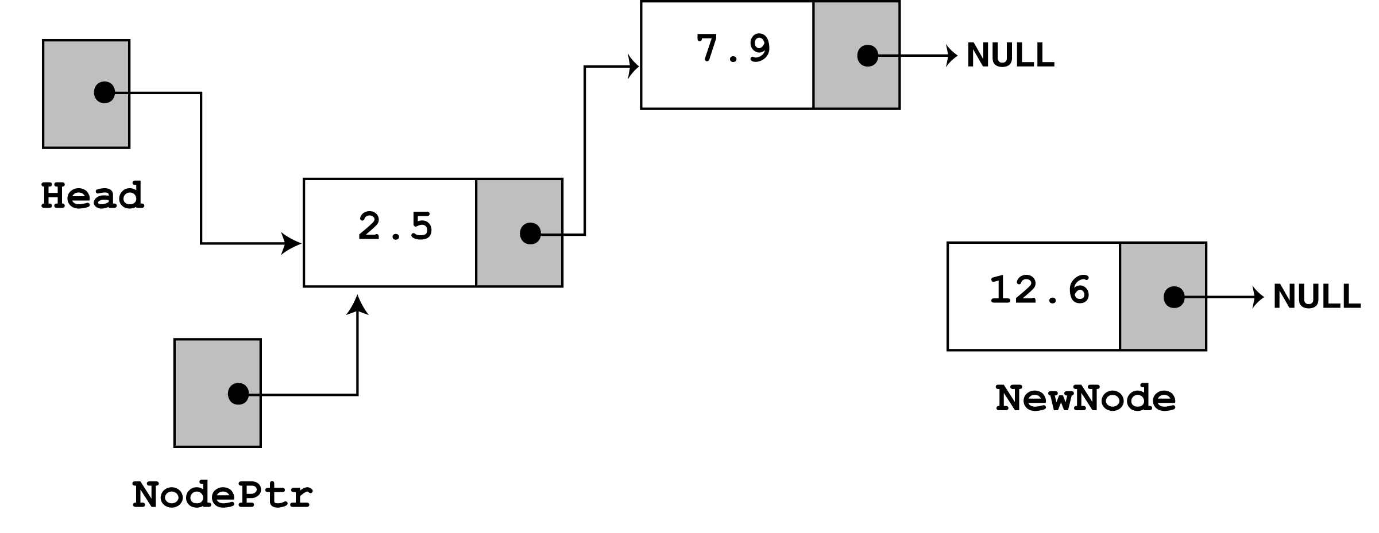
next, the else part of the if statement executes. As before, nodePtr is made to point to the same node as head.

Slide 33
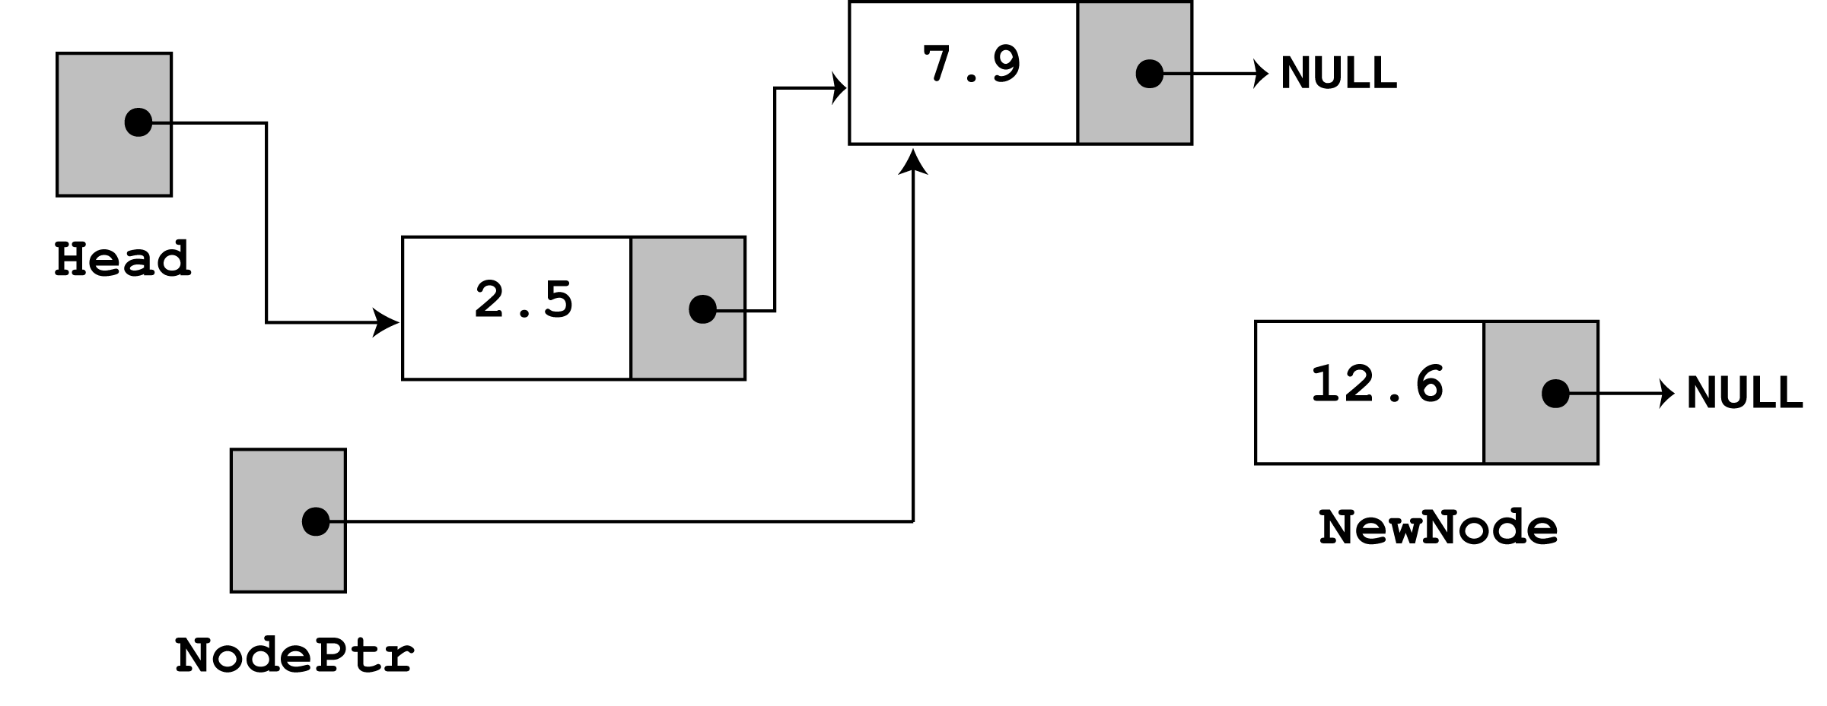
Since nodePtr->next is not NULL, the while loop will execute. After its first iteration, nodePtr will point to the second node in the list.

Slide 34
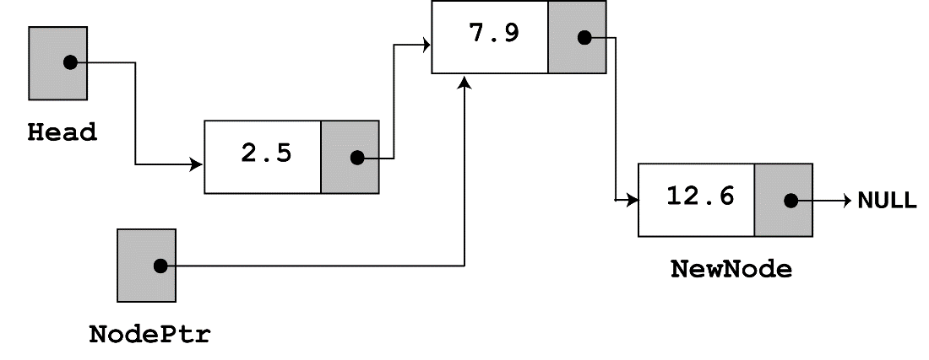
The while loop's conditional test will fail after the first iteration because nodePtr->next now points to NULL. The last statement, nodePtr->next = newNode; causes
nodePtr->next to point to the new node. This inserts newNode at the end of the list
The figure above depicts the final state of the linked list.

Slide 35
Traversing the List
The displayList member function traverses the list, displaying the value member of each node. The following pseudocode represents the algorithm. The C++ code for the member function follows on the next slide.
Assign List head to node pointer.
While node pointer is not NULL
Display the value member of the node pointed to by node pointer.
Assign node pointer to its own next member.
End While.

Slide 36
void FloatList::displayList(void)
{
ListNode *nodePtr;
nodePtr = head;
while (nodePtr)
{
cout << nodePtr->value << endl;
nodePtr = nodePtr->next;
}
}

Slide 37
Program 17-2
// This program calls the displayList member function.
// The funcion traverses the linked list displaying
// the value stored in each node.
#include <iostream.h>
#include "FloatList.h"
void main(void)
{
FloatList list;
list.appendNode(2.5);
list.appendNode(7.9);
list.appendNode(12.6);
list.displayList();
}

Slide 38
Program 17-2 Output
2.5
7.9
12.6

Slide 39
The End

Slide 40
Inserting a Node(refer word Doc)
Using the listNode structure again, the pseudocode on the next slide shows an algorithm for finding a new node’s proper position in the list and inserting there.
The algorithm assumes the nodes in the list are already in order.

Slide 41
Create a new node.
Store data in the new node.
If there are no nodes in the list
Make the new node the first node.
Else
Find the first node whose value is greater than or equal
the new value, or the end of the list (whichever is first).
Insert the new node before the found node, or at the end of
the list if no node was found.
End If.

Slide 42
The code for the traversal algorithm is shown below. (As before, num holds the value being inserted into the list.)
// Initialize nodePtr to head of list
nodePtr = head;
// Skip all nodes whose value member is less
// than num.
while (nodePtr != NULL && nodePtr->value < num)
{
previousNode = nodePtr;
nodePtr = nodePtr->next;
}
The entire insertNode function begins on the next slide.

Slide 43
void FloatList::insertNode(float num)
{
ListNode *newNode, *nodePtr, *previousNode;
// Allocate a new node & store Num
newNode = new ListNode;
newNode->value = num;
// If there are no nodes in the list
// make newNode the first node
if (!head)
{
head = newNode;
newNode->next = NULL;
}
else // Otherwise, insert newNode.
{
// Initialize nodePtr to head of list
nodePtr = head;
// Skip all nodes whose value member is less than num.
while (nodePtr != NULL && nodePtr->value < num)
{
previousNode = nodePtr;
nodePtr = nodePtr->next;
}
Continued on next slide…

Slide 44
Continued from previous slide.
// If the new mode is to be the 1st in the list,
// insert it before all other nodes.
if (previousNode == NULL)
{
head = newNode;
newNode-> = nodePtr;
}
else
{
previousNode->next = newNode;
newNode->next = nodePtr;
}
}
}

Slide 45
Program 17-3
// This program calls the displayList member function.
// The function traverses the linked list displaying
// the value stored in each node.
#include <iostream.h>
#include "FloatList.h”
void main(void)
{
FloatList list;
// Build the list
list.appendNode(2.5);
list.appendNode(7.9);
list.appendNode(12.6);
// Insert a node in the middle
// of the list.
list.insertNode(10.5);
// Dispay the list
list.displayList();
}

Slide 46
Program 17-3 Output
2.5
7.9
10.5
12.6

Slide 47
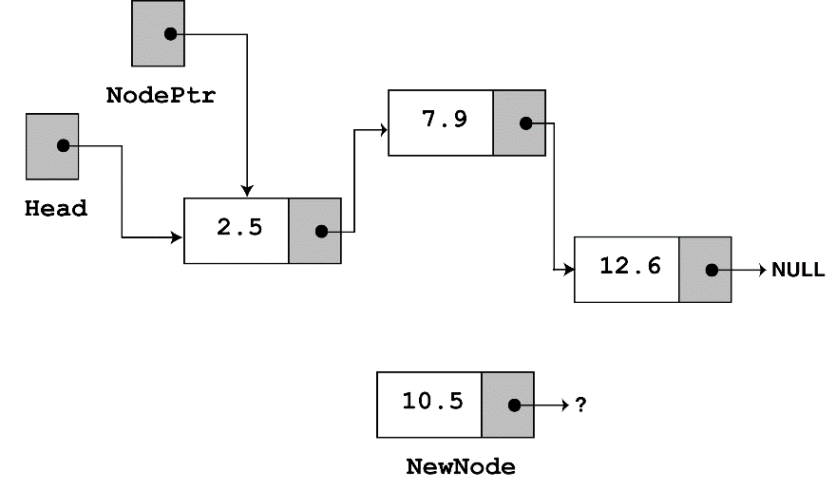
In insertNode, a new node is created and the function argument is copied to its value member. Since the list already has nodes stored in it, the else part of the if statement will execute. It begins by assigning nodePtr to head.

Slide 48
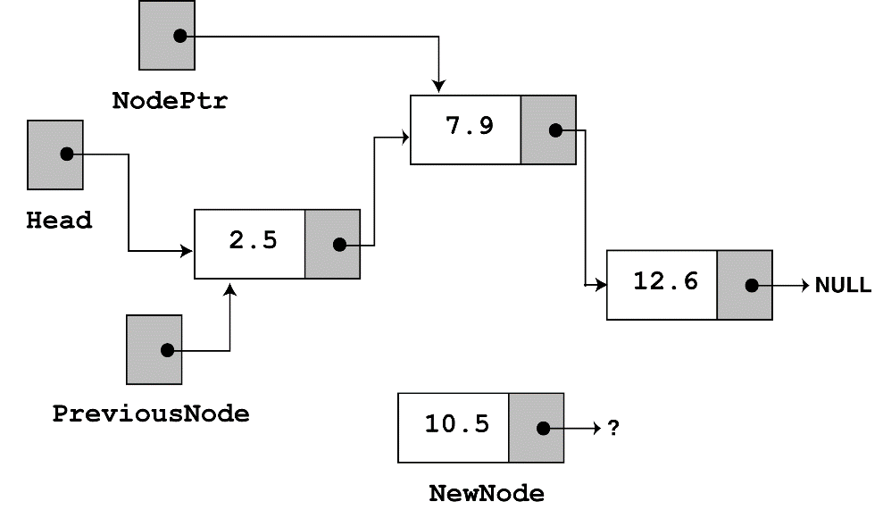
Since nodePtr is not NULL and nodePtr->value is less than num, the while loop will iterate. During the iteration, previousNode will be made to point to the node that nodePtr is pointing to. nodePtr will then be advanced to point to the next node.

Slide 49
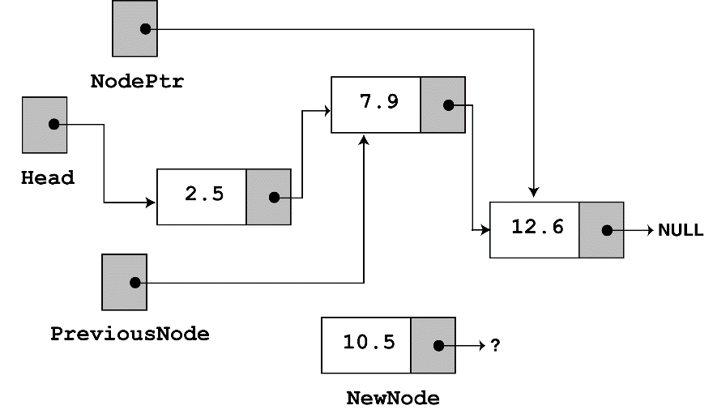
Once again, the loop performs its test. Since nodePtr is not NULL and nodePtr->value is less than num, the loop will iterate a second time. During the second iteration, both previousNode and nodePtr are advanced by one node in the list.

Slide 50
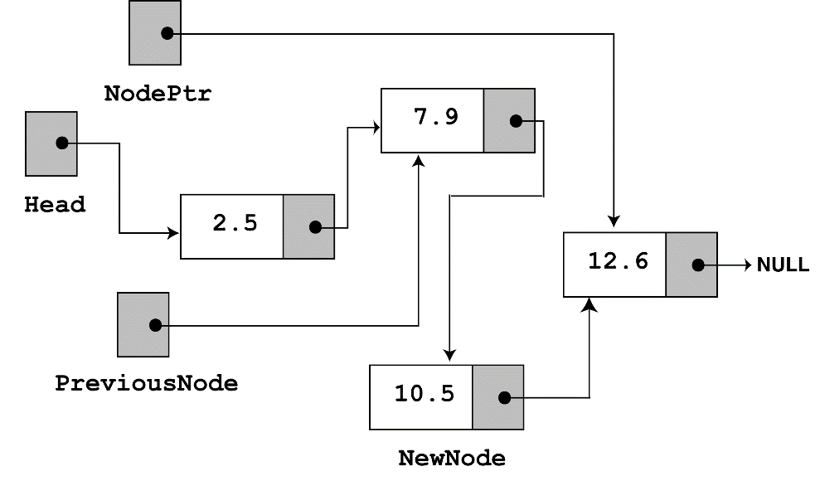
This time, the loop's test will fail because nodePtr is not less than num. The statements after the loop will execute, which cause previousNode->next to point to newNode, and
newNode->next to point to nodePtr.
If you follow the links, from the head pointer to the NULL, you will see that the nodes are stored in the order of their value members.

Slide 51
Deleting a Node
Deleting a node from a linked list requires two steps:
  Remove the node from the list without breaking the links created by the next pointers
  Deleting the node from memory
The deleteNode function begins on the next slide.

Slide 52
void FloatList::deleteNode(float num)
{
ListNode *nodePtr, *previousNode;
// If the list is empty, do nothing.
if (!head)
return;
// Determine if the first node is the one.
if (head->value == num)
{
nodePtr = head->next;
delete head;
head = nodePtr;
}
Continued on next slide…

Slide 53
Continued from previous slide.
else
{
// Initialize nodePtr to head of list
nodePtr = head;
// Skip all nodes whose value member is
// not equal to num.
while (nodePtr != NULL && nodePtr->value != num)
{
previousNode = nodePtr;
nodePtr = nodePtr->next;
}
// Link the previous node to the node after
// nodePtr, then delete nodePtr.
previousNode->next = nodePtr->next;
delete nodePtr;
}
}

Slide 54
Program 17-4
// This program demonstrates the deleteNode member function
#include <iostream.h>
#include "FloatList.h“
void main(void)
{
FloatList list;
// Build the list
list.appendNode(2.5);
list.appendNode(7.9);
list.appendNode(12.6);
cout << "Here are the initial values:\n";
list.displayList();
cout << endl;
cout << "Now deleting the node in the middle.\n";
cout << "Here are the nodes left.\n";
list.deleteNode(7.9);
list.displayList();
cout << endl;
Continued on next slide…

Slide 55
Continued from previous slide.
cout << "Now deleting the last node.\n";
cout << "Here are the nodes left.\n";
list.deleteNode(12.6);
list.displayList();
cout << endl;
cout << "Now deleting the only remaining node.\n";
cout << "Here are the nodes left.\n";
list.deleteNode(2.5);
list.displayList();
}

Slide 56
Program Output
Here are the initial values:
2.5
7.9
12.6
Now deleting the node in the middle.
Here are the nodes left.
2.5
12.6
Now deleting the last node.
Here are the nodes left.
2.5
Now deleting the only remaining node.
Here are the nodes left.

Slide 57
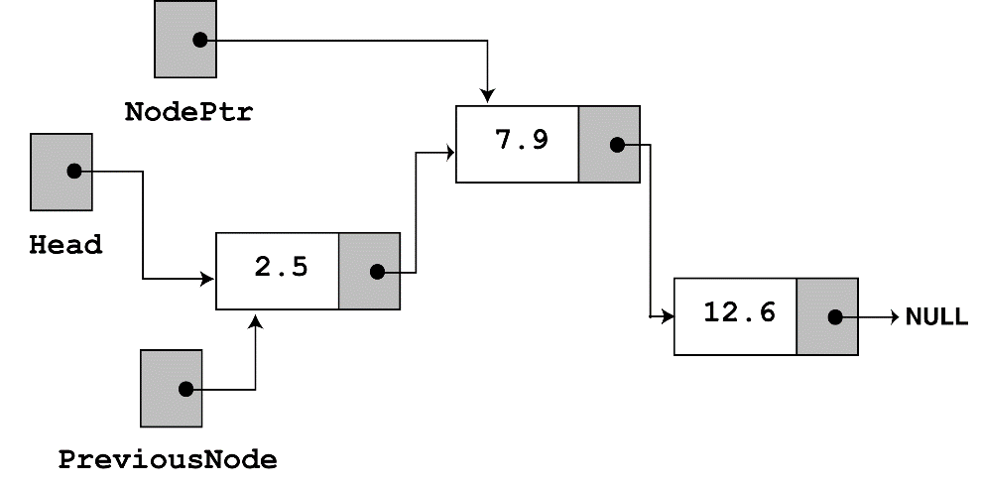
Look at the else part of the second if statement. This is where the function will perform its action since the list is not empty, and the first node does not contain the value 7.9. Just like insertNode, this function uses nodePtr and previousNode to traverse the list. The while loop terminates when the value 7.9 is located. At this point, the list and the other pointers will be in the state depicted in the figure below.

Slide 58
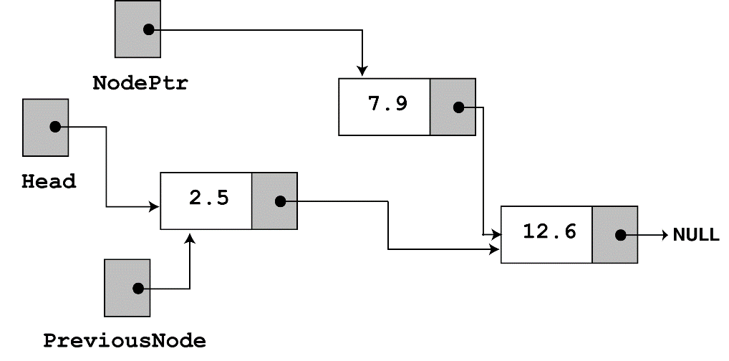
next, the following statement executes.
previousNode->next = nodePtr->next;
The statement above causes the links in the list to bypass the node that nodePtr points to. Although the node still exists in memory, this removes it from the list.
The last statement uses the delete operator to complete the total deletion of the node.

Slide 59
Destroying the List
The class's destructor should release all the memory used by the list.
It does so by stepping through the list, deleting each node one-by-one. The code is shown on the next slide.

Slide 60
FloatList::~FloatList(void)
{
ListNode *nodePtr, *nextNode;
nodePtr = head;
while (nodePtr != NULL)
{
nextNode = nodePtr->next;
delete nodePtr;
nodePtr = nextNode;
}
}
Notice the use of nextNode instead of previousNode. The nextNode pointer is used to hold the position of the next node in the list, so it will be available after the node pointed to by nodePtr is deleted.

